Slide 1
Microcontrollers – day 2

Slide 2
Agenda
We will learn 4 new concepts:
Interrupts
PWM (Phase-Width-Modulation)
Timer/counter
ADC (Analog-Digital-Converter)
Tasks:
Use interrupts to get LEDs to blink at even intervals
Use PWM to control the brightness of LEDs
Read voltage from a potmeter using ADC
Notes:
Liten datamaskin, inneholder: Prosessor RAM
Flash
EEPROM
Har mange Moduler: IO
Timere
ADC/DAC
Kommunikasjon (UART TWI SPI USB)
Metallpiner rundt chippen:
Arrangert i porter, grupper på 8
(8 -bits kontrollere).

Slide 3
Interrupts
Code blocks that are executed immediately when a precondition is met («interrupts» normal execution)
Stops the main program flow temporarily, resumes immediately after interrupt
Main program
Main program resumed
Interrupt code
Time

Slide 4
Interrupts
Useful if you have a piece of code that only needs to execute once in a while
- Button handling, receive message etc
Frees up the CPU to do other things
Main program
Main program resumed
Interrupt code
Time

Slide 5
Interrupt routine
Special function thats called automatically when both:
- interrupt request preconditions met
- the corresponding interrupt is enabled
- global interrupts are enabled

Slide 6
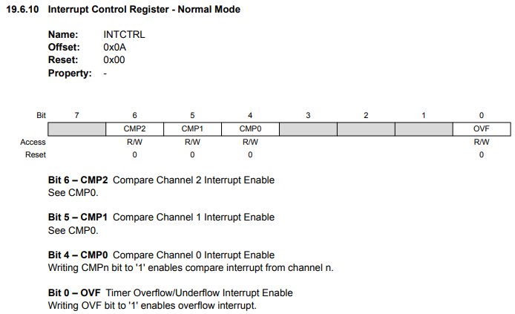
Interrupts
Interrupts must be enabled through registers:

Slide 7
Interrupt routine
To declare:
ISR = Interrupt Service Routine (macro)
TCA0_OVF_vect = the interrupt vector name
Requires #include <avr/interrupt.h> Remember to call sei() to enable global interrupts

Slide 8
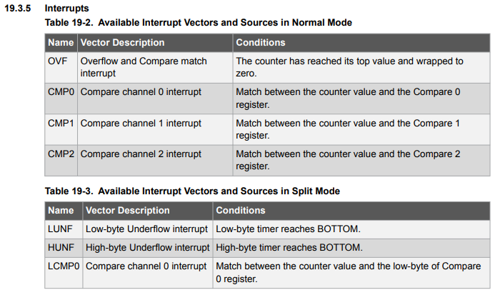
Interrupt routine
- Interrupt vectors are found in the data sheet.
- Other possible vectors for the timer A module:

Slide 9
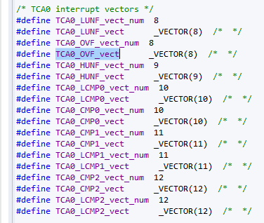
Interrupt routine
In <avr/interrupt.h> they are defined as follows:

Slide 10
Interrupts – a few tips
MegaAVR 0-Series has two interrupts levels, 0 (default) and 1.
Keep your interrupts short (in terms of execution time)
Interrupts are often, but not always, the answer to your problems

Slide 11
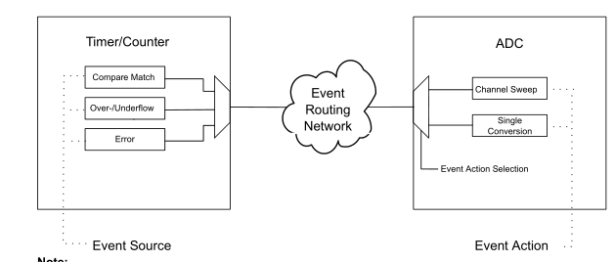
Event System
Peripheral to peripheral communication
Enables reaction to precondition without involving the CPU
Great for low power and time critical tasks
Six channels

Slide 12
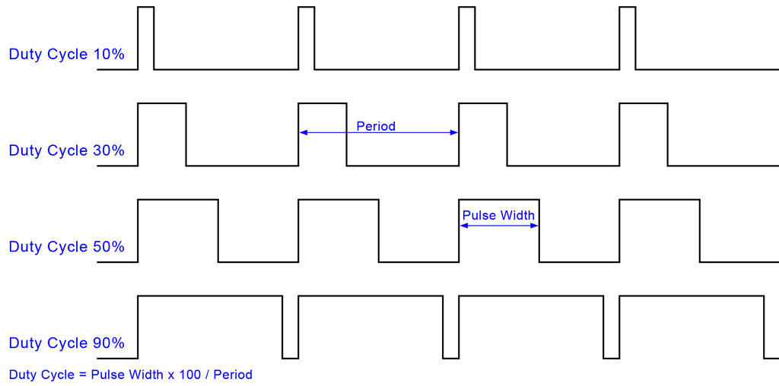
PWM
From wikipedia:
«In electronics and telecommunications, modulation is the process of varying one or more properties of a periodic waveform, called the carrier signal, with a modulating signal that typically contains information to be transmitted. “

Slide 13
PWM
Useful for plenty of things:
Motor control
Led brightness control
Information transmission over long wires
Digital to analog converters
Etc
When used with a LED it will make the it appear more or less bright, proportional to the Duty Cycle. The higher the Duty cycle, the more light from the LED.

Slide 14
USART
Universal Synchronous Asynchronous Receiver Transmitter
Simple communications protocol
Synchronous = extra wire for shared clock
Asynchronous = no wire for shared clock
Data usually sent in chunks of 8 bits
Can have simple error checking

Slide 15
UART
We use asynchronous mode in this assignment
Asynchronous means that both parts need to know what speed is being used
Baudrate = symbol rate, transmission speed, must be correctly set. In this lab, we use a baud rate of 9600. Note: This is NOT the value to be inserted in the BAUD register.

Slide 16
UART - BAUD register value:
The value to insert into the baud register is calculated based on the desired baud rate and the frequency of the peripheral clock.
S = 16 (normal mode ) f_baud = 9600 CLK_PER = 3.33 MHz

Slide 17
UART
Extra components on the dev board do uart<->USB translation
Enables sending data to your computer using UART
Receive/transmit with PUTTY or similar programs

Slide 18
UART
Necessary setup of UART:
- Set data length
- Set baudrate (transmission speed)
- Set number of stop bits
- Select asynchronous operation
- Enable receiver and transmitter

Slide 19
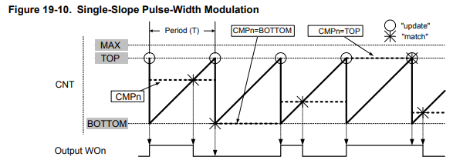
Timer/Counter
Dedicated unit for counting clock cycles
Extremely versatile units
Can for example be used to generate a PWM signal:

Slide 20
Timer/Counter
MegaAVR 0-Series has three timer types:
A: specialized for waveform generation (16 bit)
B: specialized for input capture and timing checks (16 bit)
D: specialized for motor control etc
We focus on the type A

Slide 21
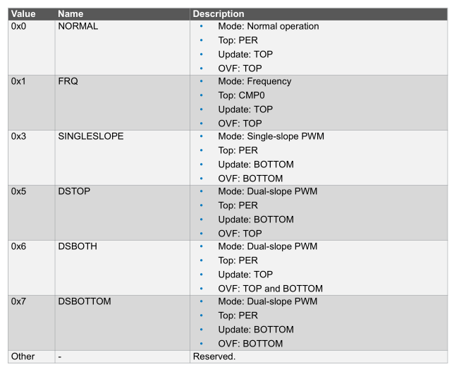
Timer/Counter
Can run in different modes:

Slide 22
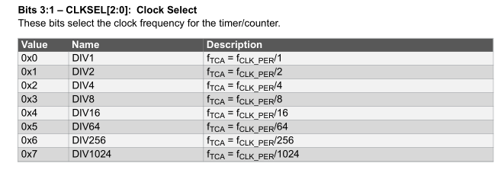
Timer/Counter
Prescaling:
A prescaler divides the input frequency by a fixed integer value.
The input to the timer is 3.33MHz by default. By using the timer prescaler, you can make it run slower (count for longer)

Slide 23
PWM with Timer
Dedicated pins on the 4809 is connected to the timers. (0-WO0 to 0-WO5).
0-WO1 is connected to port A, pin 1.
If the corresponding compare match is enabled and correct mode is selected, a PWM waveform will be generated on the pin.

Slide 24
PWM with Timer
Set the period by modifying the TOP value and the counter speed (prescaler value).
Example: If input clock of a 16-bit counter is 3.33MHz, what must prescaler and TOP value be for a period of ~ 20ms?
Many solutions, examples:
Prescaler = 16 TOP = 4 166
Prescaler = 8, TOP = 8 333
Prescaler = 4, TOP = 16 666

Slide 25
PWM with Timer
Set the Duty Cycle by modifying the compare value.
Example: For the settings in the previous slide, what value must compare be for a Duty Cycle of 50%?
Duty Cycle = Compare value / top value
For a duty cycle of 50%, Compare value = top value * 0.5
For a duty cycle of 25%, Compare value = top value * 0.25
Etc

Slide 26
Timer/Counter
Typical setup:
- Set WO pins as output (portx.dir-register)
- Enable timer (ctrl-registers) - Select timer mode (ctrl-registers)
- Select prescaling factor (ctrl-registers)
- Select top value (if aplicable) (per registers)
- Select compare value (if applicable) (comp registers)
- Enable compare match (ctrl-registers)
- Implement ISR (if applicable)
- Enable interrupt (if applicable) (intctrl-registers)
- Enable global interrupts ( sei() )

Slide 27
Timer/Counter
Note about inverted LEDs:
Since the LEDs on the board are active LOW, you need to invert the phase of the PWM in one of two possible ways:
1) Invert the output pins directly in the PORT module
2) Invert the value in the compare register like so:
InvertedCompareVal = TOP – regularCompareVal
In other words, for option 2: CompareVal = TOP => LEDs off
CompareVal = 0 => LEDs max on

Slide 28
Analog-to-digital converter (ADC)
Converts an analog, continuous, signal into discrete representation.
Both continuous time and voltage are converted into discrete values in a conversion.
Resolution measured in bits (eq. 10 bits)
Sampling rate (or sampling frequency) determines the rate at which values are converted.
Nyquist theorem states that the sample frequency has to be twice that of the highest frequency in the sampled signal (Fs >= 2* Fsig)
Notes:
28

Slide 29
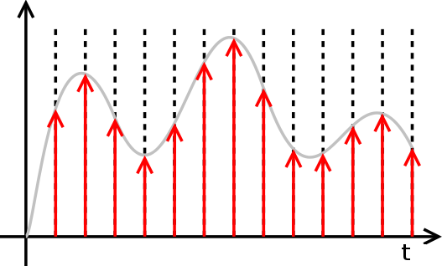
ADC basics cont’d
Notes:
29

Slide 30
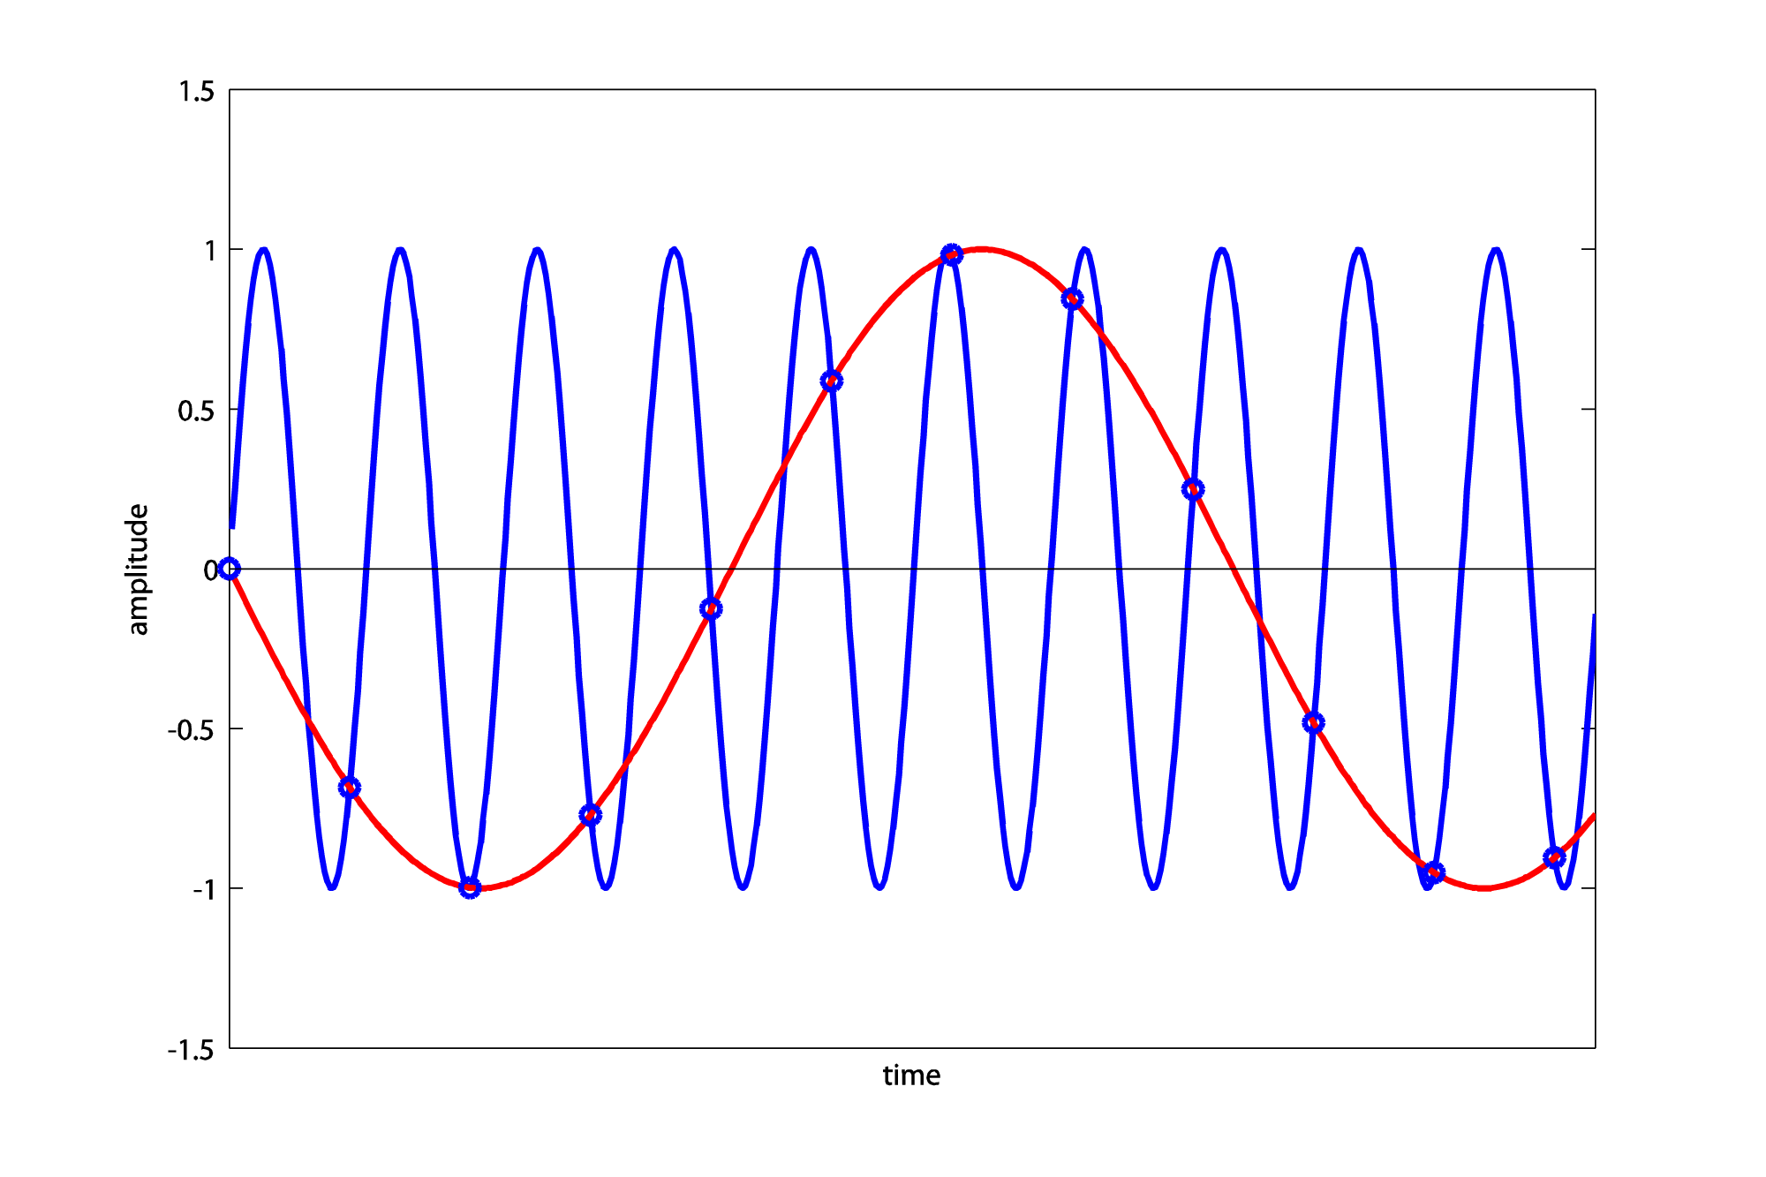
Aliasing
Notes:
30

Slide 31
ADC usage on the AVR
Initializing an ADC on the AVR can be accomplished like this:
Set the bit resolution (we use 8 bit in this task)
Select the reference voltage
Set the ADC clock prescaler so the speed is between 50kHz and 2MHz
Enable the ADC
Getting a sample from the ADC:
Choose which ADC input channel to use
Clear the «ADC conversion done» interrupt flag.
Start a new conversion.
Wait for the conversion to complete by monitoring the interrupt flag.
Read out the value from the result register.
Notes:
31

Slide 32
Agenda
Tasks:
Timers
Set up a timer to blink a LED by generating interrupts
Set up a timer to dim a LED by automatic compare matching
ADC
Set up the ADC to read voltage from a potmeter. The result can be transmitted over UART
Notes:
Liten datamaskin, inneholder: Prosessor RAM
Flash
EEPROM
Har mange Moduler: IO
Timere
ADC/DAC
Kommunikasjon (UART TWI SPI USB)
Metallpiner rundt chippen:
Arrangert i porter, grupper på 8
(8 -bits kontrollere).

